Slide 1
Note for the honourable teachers
The subject teachers are requested to read the notes given below some of the slides.
A note is given bellow the slide no. 5, 9, 10, 11, 12, 13.

Slide 2
WELCOME
TO
OUR TODAY’S ENGLISH CLASS

Slide 3
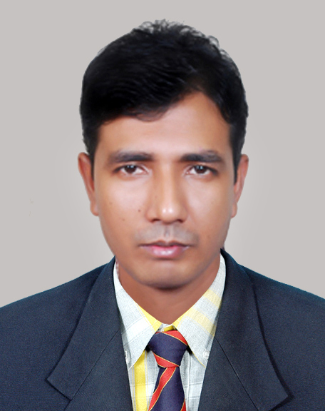
Prepared and presented by:
Suronjit Dey
Asst. Teacher (English)
Jamal Khan Kusum Kumari City Corp. Girls’ High School,Chittagong
Cell:01811110648;01991954085
Email:deysuronjit08@gmail.com

Slide 4
English First Paper
Class:8
Time:45 Minutes

Slide 5
Look at the picture :
What do you see in the picture?
How does she look?
What is your opinion about her present condition?
Shamima with two customers in her shop
She looks very happy
In spite of spending a miserable married life,she is ever beautiful
Notes:
Teacher will try to elicit the answer from the SS. If they fail ,Teacher will give feedback by clicking .

Slide 6
Our Today’s Lesson……..
Ever Beautiful Shamima
Unit:05; Lesson:03

Slide 7
Learning Outcomes
After the end of the lesson, learners will be able to….
Ask and answer questions.
Infer meaning from context.
Talk about picture.
Read and understand text through silent reading.

Slide 8
Look at the picture and talk about it with your partner. You may use the following questions:
Pair Work
1.Who did Shamima work with?
2.What is Shamima’s present dream?

Slide 9
B. Open at page no.49 and read the text silently:
Notes:
Teachers are requested to use this slide only for those who don’t have text with them.

Slide 10
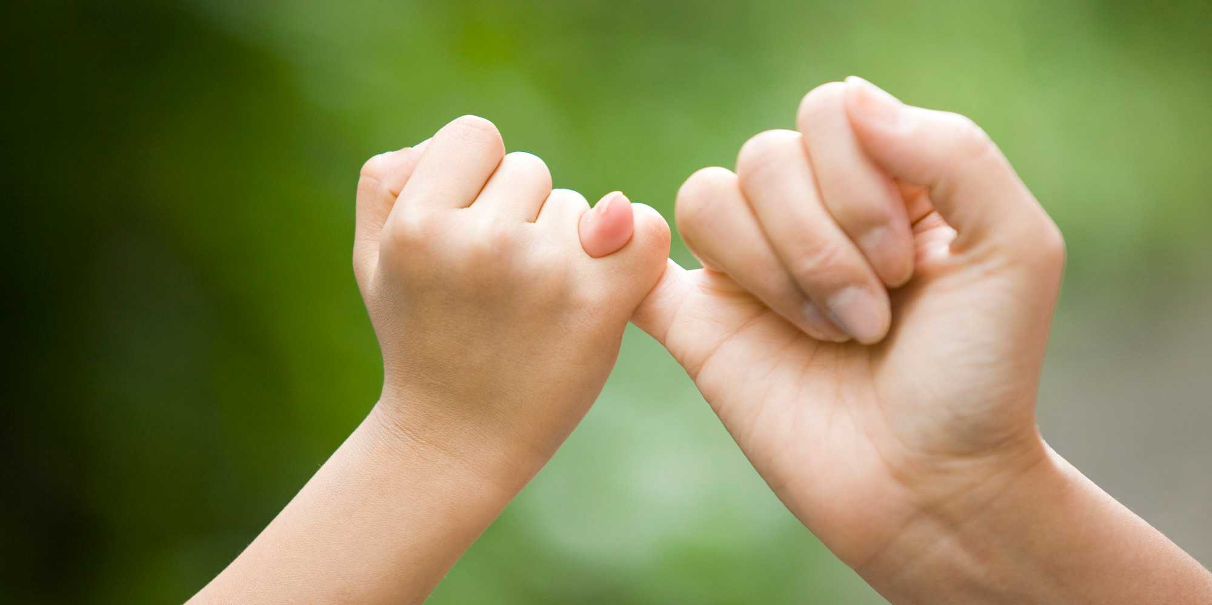
Vocabulary Presentation
Vows
Promise
They vow to work hard.
Notes:
Teacher will try to elicit the answer from the SS. If they fail ,Teacher will give feedback by clicking .

Slide 11
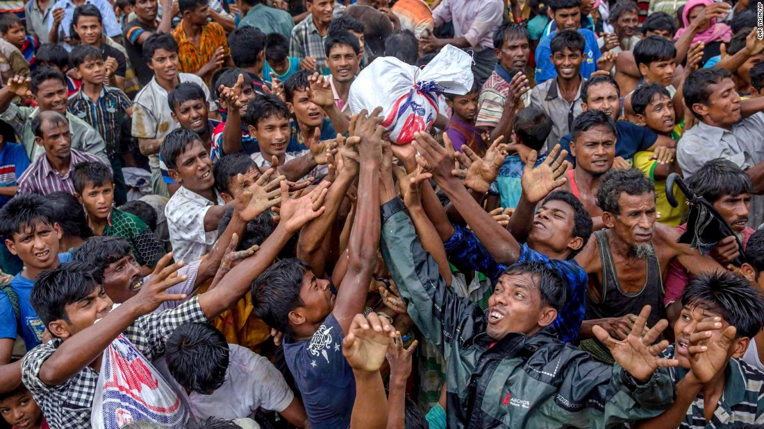
Vocabulary Presentation
Ill-fated
Unlucky
They are ill-fated.
Notes:
Teacher will try to elicit the answer from the SS. If they fail ,Teacher will give feedback by clicking .

Slide 12
Vocabulary Presentation
Outward
Going out
Don’t judge anything seeing its outward beauty.
Notes:
Teacher will try to elicit the answer from the SS. If they fail ,Teacher will give feedback by clicking .

Slide 13
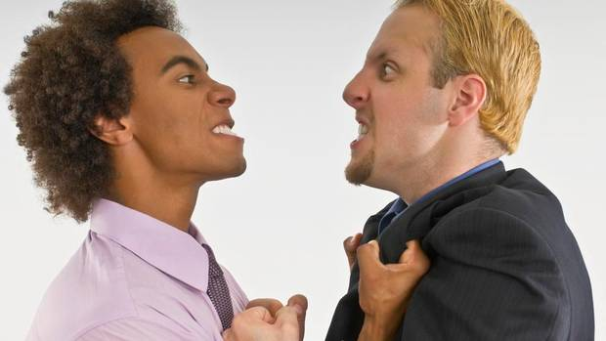
Vocabulary Presentation
Grudges
Hatred
But she has no grudges against anyone.
Notes:
Teacher will try to elicit the answer from the SS. If they fail ,Teacher will give feedback by clicking .

Slide 14
Group Work
C. Now, discuss both the terms in group- “Outward beauty” and “Beauty of mind” and write the answer of the following question:
What do you understand by, “Her husband could destroy her outward beauty but not the beauty of her mind.?”

Slide 15
Evaluation
True or false? If false give the correct answer.
1.Shamima’s husband destroyed her.
2.Shamima promised to stand beside the helpless women.
3.She has some trainers to train the women of her organization.
4.Shamima wants to become a wealthy person to help others.
Notes:
Teacher will try to elicit the answer from the SS. If they fail ,Teacher will give feedback by clicking .

Slide 16
Home task
E. Find a person in your locality who has succeeded in the face of difficulties and write a paragraph on that successful person.You can use the clues: name,age,relation with you,points of success,why to appreciate etc.

Slide 17
Thanks For The Day

